Slide 1
What we have learned from project?

Slide 2
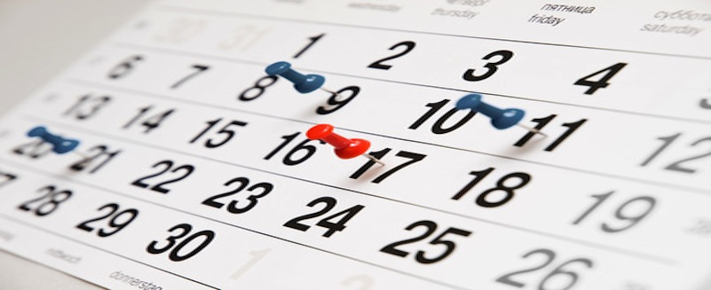
Meet in person
Scheduling meeting can be hard, but it is necessary.

Slide 3

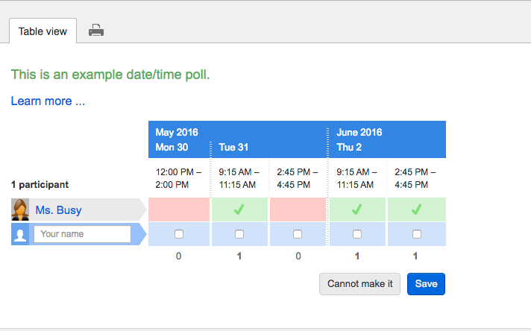
How to do better?
Using tools.

Slide 4

Milestones are important.

Slide 5
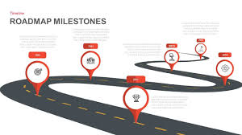
Strictly follow the milestones.

